Slide 1

GALGOTIAS UNIVERSITY
Plot No.2, Sector -17 A, Yamuna Expressway,
Greater Noida, Gautam Buddha Nagar, U.P., India
SCHOOL OF COMPUTING SCIENCE & ENGINEERING
CAT-3 Case Study Report File Submission
Course Name: COMPUTER WORKSHOP
Course Code: BCS01T1004
School: SCSE Year: 1st Semester: 1
Program: B. TECH Session: 2021-2022
Submitted To: | Submitted By:
Mrs. Indravati | AVIRAL GAURAV(21SCSE1300029) ABHINAV KUMAR CHOUDHARY(21SCSE1011615) AMIT SINGH(21SCSE1410106)

Slide 2
Steps how chats
And mails are sent

Slide 3
WHAT IS EMAILS
The term “email” stands for “electronic mail”. The electronic mail is introduced first in the 1960s .
However, it became available in the current structure in the 1970s.
It is a method of exchanging messages between two peoples using electronic devices.
Protocols used in email systems :
IMAP (Internet Mail Access Protocol)
POP (Post Office Protocol)
SMTP (Simple Mail Transfer Protocol)

Slide 4
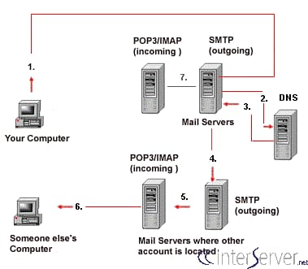
MAIL SERVER
A mail server is a computer application. It receives incoming emails from the local users (people within same domain) as well as remote senders and forward outgoing email for delivery.
A computer having such an application installed can also be called as a mail server.
Mail Server are used for outgoing and incoming emails.

Slide 5
DNS
The DNS stands for Domain Name System.
The purpose of the DNS is to translate the domain names to the IP addresses and vise-versa.
The DNS is used here to find out the mail server of the other side.
The information is retrieved from the DNS and the email message is sent to the particular email address.

Slide 6
HOW EMAILS WORK
First the sender needs to enter the email address of the recipient along with the message using an email application, click the “Send” button.
In the DNS zone, for the receiver address’ domain, there will be an MX record (stands for Mail Exchanger record). This is a DNS resource record which specifies the mail server of a domain, after DNS lookup, a response is given to the requested mail server. This way the ‘to’ mail server is identified.
The next step is transferring the message between the mail servers. The SMTP protocol is used for this communication.
This message is transferred to the Mail Delivery Agent and then it is transferred to the recipient’s local computer.

Slide 7
THANKING YOU!!

